Slide 1
Mass Movement.

Slide 2
What is mass movement.
Mass movement is the movement of regolith down slopes under the influence of gravity.
Regolith is loose material formed from weathering.
It includes soil, mud and loose rock produced by weathering.

Slide 3
Influences on mass movement
Gradient; Mass movement is fastest on a steep slope.
Water content; water makes regolith wet and heavy and more likely to move downhill.
Human Activity; People often cut into the side of a hill, making the slope steeper. This may cause material to collapse.
Vegetation; the roots of plants bind the soil particles together and this slows down the rate of mass movement.

Slide 4
Types of mass movement.
SLOW
Soil Creep.
FAST
Landslides.
Bogbursts.
Mudflows.

Slide 5
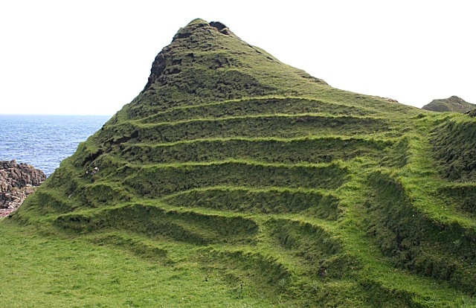
Soil Creep.
This is the slowest type of mass movement.
It is only identifiable by its effects on the landscape.
Electric poles and fence posts lean over, stone walls bulge and sometimes break and teracettes form on hill sides.
p.50. Diagram 9.2

Slide 6
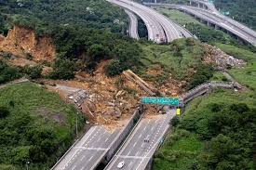
Landslides.
A land slide is a very fast movement of soil or rock down a steep slope.
It happens when a slope becomes unstable.
It is caused by coastal erosion, road building or quarrying.
It often occurs after heavy rain.
P.50. Diagrams 9.3
Landslide occurred in 2011 near Ballyferriter in Co.Kerry.

Slide 7
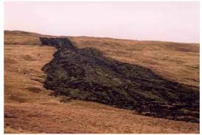
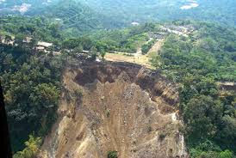
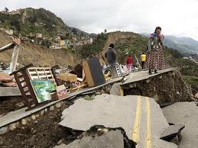
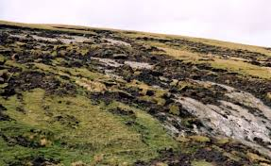
Mudflow
A mud flow is a river of rock, soil and water.
These are the fastest form of mass movement.
Mudflows are often triggered off by heavy rainfall.
They are sudden and often silent and therefore can be deadly.
Case study p.51,
Sri Lanka, 2016.

Slide 8
Bog burst.
A bog burst occurs when peat flows down a hill side.
This happens when the vegetation is stripped from blanket bogs.
This is fast and dangerous.
P. 51 Bogburst, Galway 2016.

